Slide 1

Sentiment Analysis of Russia’s invasion of Ukraine
By - Ajit Jadhav, Srashti Soni , Karan Ajay Pisay, Shree Sharma
Under the guidance of Dr. Tony Diana
Data Science Department, UMBC
Data 602:Intro to Data Analysis and Machine Learning

Slide 2




Our team:
Karan Ajay Pisay Srashti Soni Shree Sharma Ajit Jadhav
LP07698 CV33938 JY19575 VA96495

Slide 3
Table of Contents
01
02
03
Introduction
Datasets
Methodology
04
05
06
Sentiment Analysis
ML Models
Conclusion & Future Work

Slide 4
01
Introduction

Slide 5
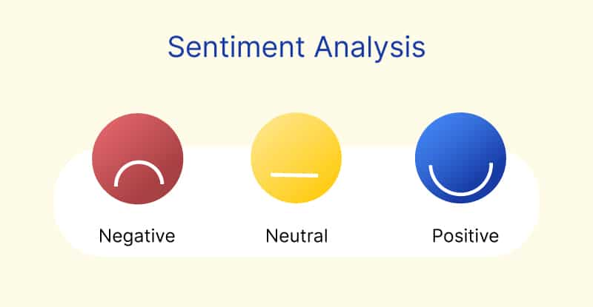
INTRODUCTION
What is Sentiment Analysis?
Identifying and categorizing opinions stated in a piece of text computationally, especially to see if the writer's attitude toward a specific topic is positive, negative or neutral
Also referred to as opinion mining
Uses a combination of natural language processing (NLP) and machine learning (ML) approaches

Slide 6
Hypothesis & Approach
Hypothesis & questions:
Hypothesis: Overall sentiment of the people around globe will be negative
What are the effects of the invasion on the sentiments of people around the world?
What are the sentiments before the invasion and after the invasion happened?
Approach:
Sentiment analysis of Twitter and Google News
Sentiment analysis of different timelines
Analyzing country wise data (USA, CA, IND, and UK)

Slide 7
02
Datasets

Slide 8
Data Description
Datasets
Twitter
Google News
Before Invasion
After Invasion
Country-wise

Slide 9
About the Data
Twitter data has been extracted using Twitter API
It has data has of 300,000+ tweets related to keywords based on Russia’s invasion of Ukraine
Google News data has been extracted using pyGoogleNews library
Google News data is divided into 3 parts:
Before invasion
Country wise data(USA, CA, IND, and UK)
After Invasion

Slide 10
03
Methodology

Slide 11
Methodology
Data Gathering
Data Scraping
Exploratory Data Analysis
Sentiment Analysis
Machine Learning Models
Data Cleaning
Tokenization
Stop Words
Lemmatization
Sentiment Labeling
Data Pre-Processing
Notes:
Tokenization
Stop Words
Removing Punctuations, digits, hashtags, usernames, urls, emojis, punctuations and special characters
Sentiment Labeling : Positive, Negative & Neutral

Slide 12
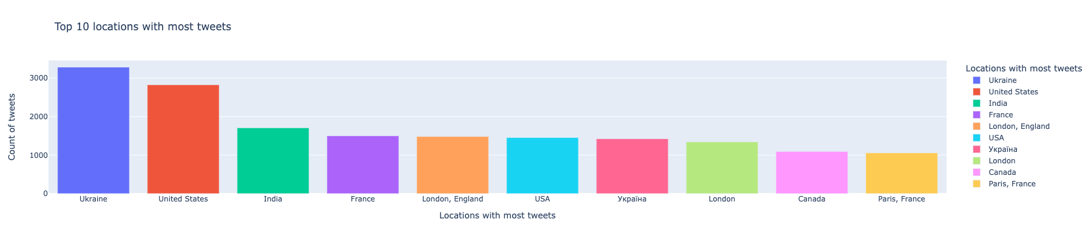

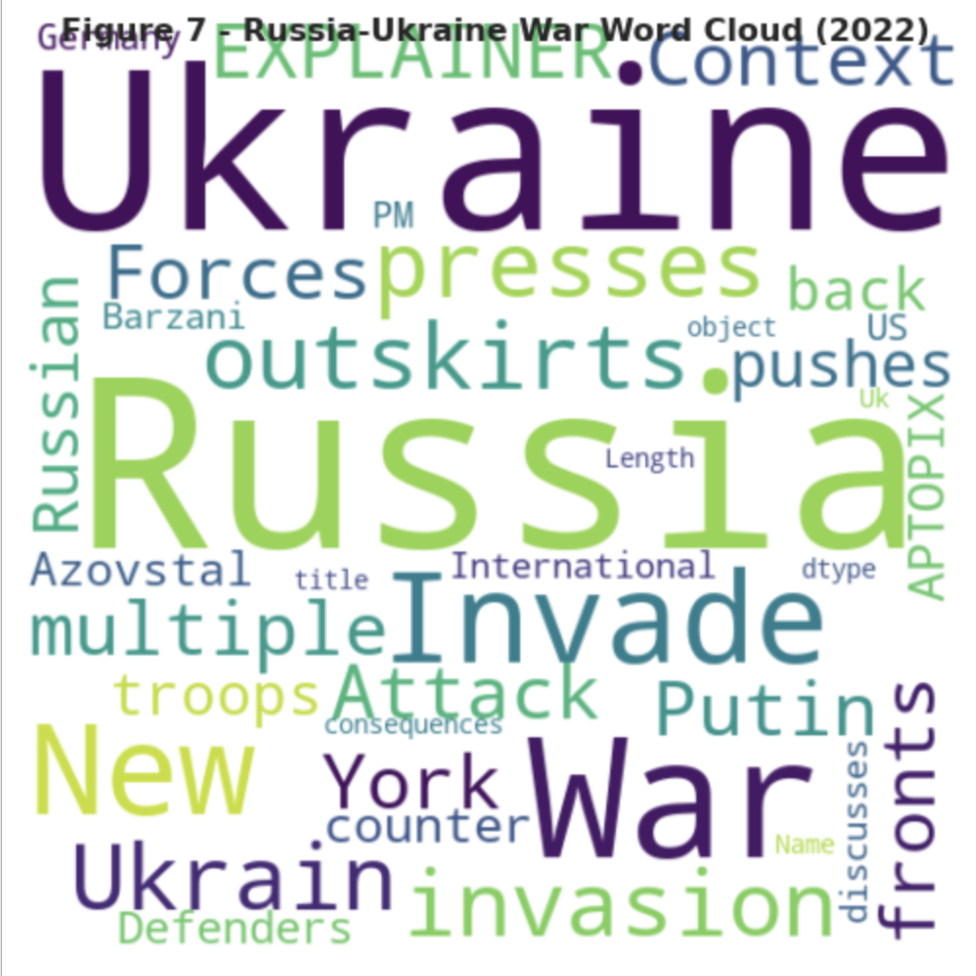
EDA

Slide 13
04
Sentiment Analysis

Slide 14
Twitter & Google News Sentiment Analysis Workflow
Ingesting the Data
Cleaning the Data
Preprocessing the Data
Modelling the Data
Using Twitter API to Gather Tweets & PyGoogleNews to Gather Google News
Remove Punctuations, Hashtags, Emojis Usernames & Limit Language
Remove Stop-Words, Tokenization, Lemmatize Words & Sentiment Labeling
Training the Algorithm on the Training Set

Slide 15
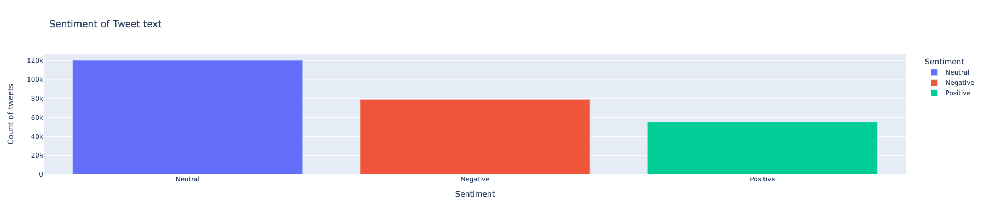
Twitter: Sentiments obtained through labeling

Slide 16
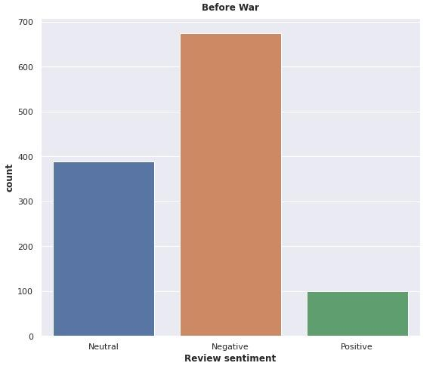
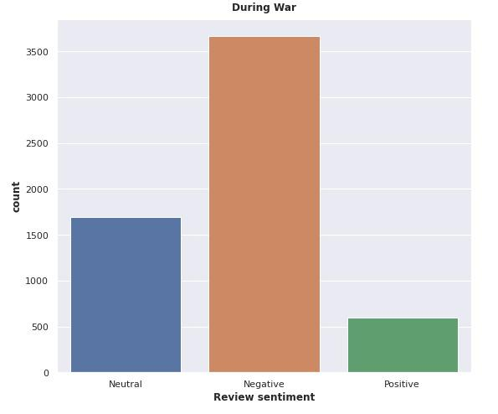
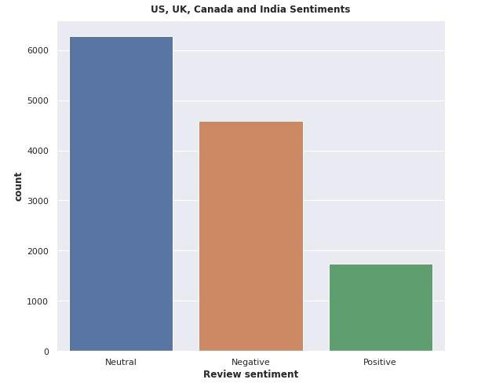
Google News: Sentiments obtained through labeling
Before Invasion
After Invasion
Combined Countries

Slide 17
05
ML Models

Slide 18
Machine Learning Models
Baseline - Naive Bayes
Pipeline
Using Transformers - BERT model

Slide 19
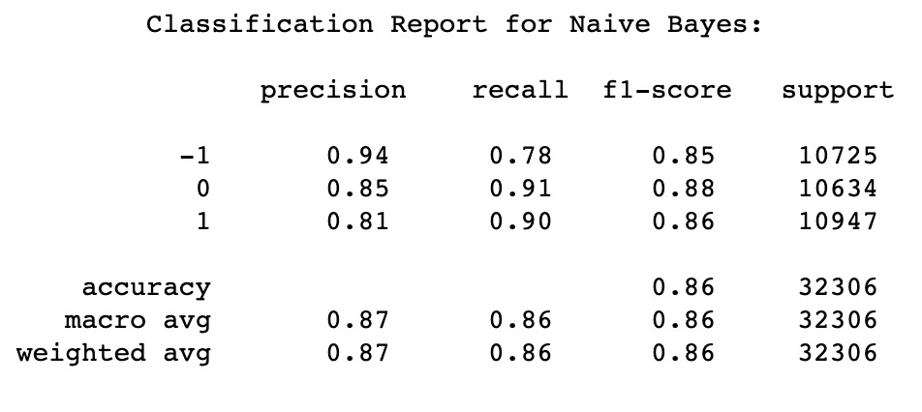
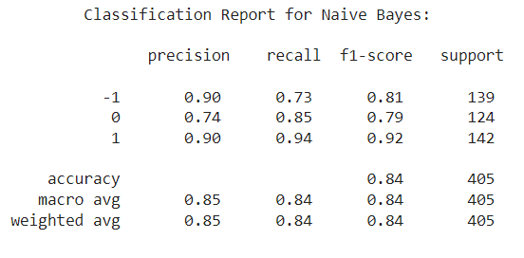
Baseline Model - Naive Bayes
BeTwitter - Classification Report
Google News - Classification Report
Note: -1 represents Neutral, 0 represents Negative & 1 represents positive

Slide 20
Pipeline Workflow
For Twitter
Decision Tree Classifier
Ridge Classifier
Random Forest
AdaBoost Classifier
Pipeline
Model Evaluation
Data Acquisition
Ridge Classifier
For Google News
Logistic Regression
Model Training
(80-20 Split)
DecisionTree Classifier
SVC

Slide 21
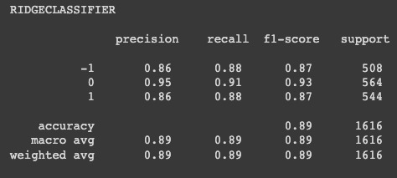
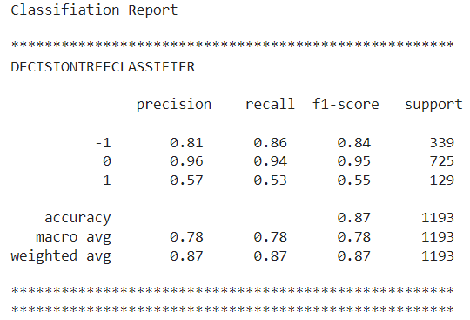
Classification Report
BeTwitter - Classification Report
Google News - Classification Report

Slide 22
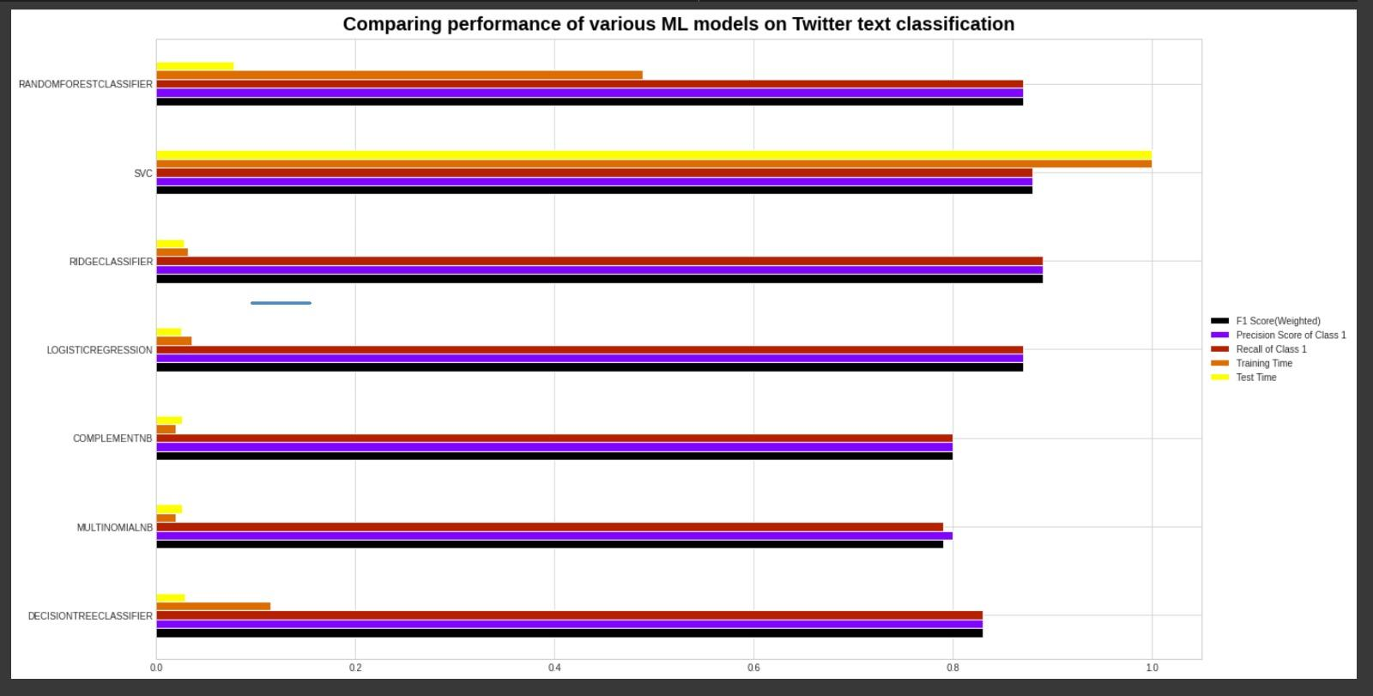
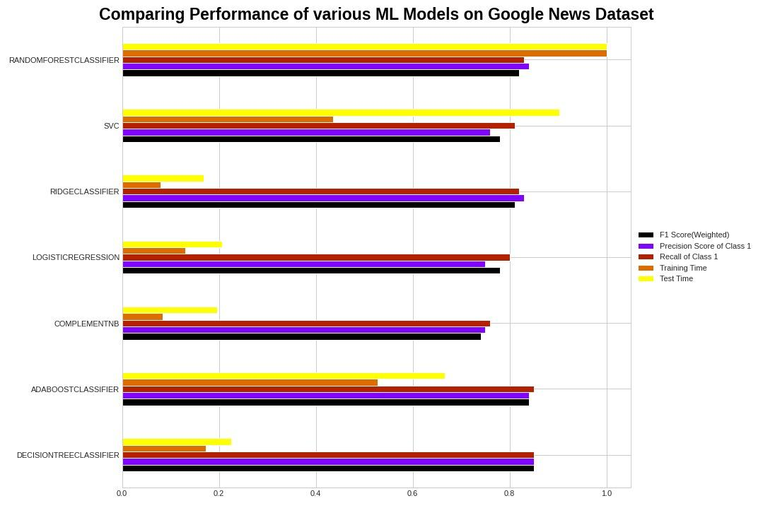
Comparison of ML models for both the Datasets

Slide 23
BERT Model
Since BERT is a Bidirectional model, it tries to look from both directions left-right, right-left. To predict a masked word BERT takes both the next token and previous token of the masked word into consideration for the prediction

Slide 24
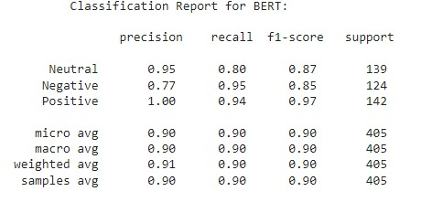
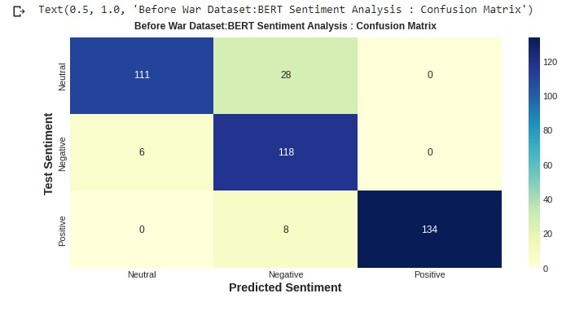
Classification Report & Confusion Matrix

Slide 25
Conclusion & Applications
As Twitter data and Google News include users from all over the world who are not directly affected by the war, as a result, a high number of tweets fall under the neutral category
For Google News: Before invasion & after invasion the overall sentiment was negative, for combined data of four countries it was Neutral
Applications:
Organizations can use this to plan-out their future course of action
Russia has been suspected of using this to spread disinformation and sway opinions online about the invasion

Slide 26
Future Work
For further analysis, we can use the BERT model in other sections of the data to acquire best accuracy
Also, we can use the upgrade version of BERT which is RoBERTa to train the model and calculate the accuracy

Slide 27
Thank You!

